Slide 1
Diffusion and osmosis
CHAPTER 2/ O’LEVEL BIOLOGY 5090 / GCE.

Slide 2
2. Diffusion and osmosis
Content
2.1 Diffusion
2.2 Osmosis
2.3 Active transport

Slide 3
Learning outcomes
Candidates should be able to:
(a) define diffusion as the movement of molecules from a region of their higher concentration to a region of
their lower concentration, down a concentration gradient;
(b) define osmosis as the passage of water molecules from a region of their higher concentration to a
region of their lower concentration, through a partially permeable membrane;
(c) describe the importance of a water potential gradient in the uptake of water by plants and the effects of
osmosis on plant and animal tissues;
(d) define active transport as the movement of ions into or out of a cell through the cell membrane, from
a region of their lower concentration to a region of their higher concentration against a concentration
gradient, using energy released during respiration.
(e) discuss the importance of active transport as an energy-consuming process by which substances are
transported against a concentration gradient, as in ion uptake by root hairs and glucose uptake by cells in
the villi.

Slide 4
DIFFUSION
The net movements of particles (atoms, ions or molecules) from a region of higher potential to a region of lower potential.

Slide 5
Potential
Potential refers to concentration of substances at one particular location
E.g. We sprinkle an aerosol spray in a room at one corner (say at point A), and take another reference point called B, than the concentration at each point is called potential at that point.

Slide 6
Concentration gradient
Net movement of molecules
From low to top is against concentration gradient.
From top to bottom
Along concentration gradient
Point A
100 molecules
Point B
1 molecule

Slide 7
Kinetic molecular theory
Why do the particle move
All molecules posses kinetic energy, they vibrate and collide with each other which produces random motion.
At point A, more molecules are present so more collision and more chances of motion. So particles have a higher chance to move from A to B.

Slide 8
Extent of diffusion
Diffusion is continuous till the potential difference is lost between point A and B.
Slope is zero
So no diffusion happens here at this point.
Point A
Point B

Slide 9
So at equal potential what happens to kinetic energy?
At equal concentration of point A and B, there is no diffusion. Although the molecules move from A to B and vice versa.
Say e.g. 100 molecules move from A to B in 1 sec
100 molecules move from B to A in 1 sec. Net loss of molecules from A is zero and net gain is also zero, so no diffusion occurs, as diffusion considers only net movement.

Slide 10
Diffusion in various substances
Diffusion is very fast in gasses
Diffusion is slow in liquids
Diffusion is impossible in solids

Slide 11
Diffusion in daily life
Air freshener sprays
Sugar dissolves uniformly in water
Ink dissolves in water

Slide 12
Diffusion and cells
The following substances enters cells by diffusion
  Carbon dioxide
  Oxygen
  water
Diffusion of water is not called diffusion (when water enters a cell)

Slide 13
Osmosis
Osmosis is diffusion of water molecules across a cell membrane OR
Osmosis is movement of water molecules from higher potential to lower potential across a cell membrane
Water could enter cell by osmosis
Water could leave cell by osmosis
(cell membrane allows freely only
  Water
  Carbon dioxide
  Oxygen)

Slide 14
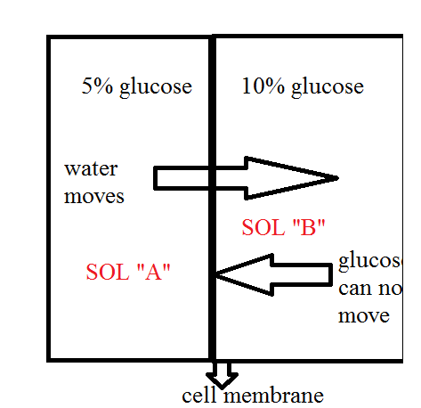
Which solution have high water potential?
Why water moves from A to B?
Which solution have low water potential?
Why not glucose move from B to A?

Slide 15
Water potential
Water potential is amount of water present
Water potential is always consider relative

Slide 16



Solution comparisons
A is HYOTONIC as compared to B OR B is HYPERTONIC as compared to A
C is HYPERTONIC as compared to B OR B is HYPOTONIC as compared to C
ALL THESE ARE RELATIVE TERMS
5% glucose
10%
glucose
15% glusose
More water than B
HYPOTONIC
Less water than A
HYPERTONIC
Less water than B
HYPERTONIC

Slide 17
Osmosis and living cells
All the water is absorbed by cells via osmosis
Cells can loose water by osmosis

Slide 18
A plant cell in solution of high water potential (HYPOTONIC)
Water potential outside cell is high
Water enters cells by osmosis (endosmosis)
Absorbed water is stored in vacoule (store house of a cell).
Cell size increase, it exert a force on cell wall, this force creates a pressure called TURGOR PRESSURE
Such cell is called TURGID CELL

Slide 19


Normal cell, placed in solution with high water potential.
Water enters cell by osmosis,
TURGIDITY
TURGOR PRESSURE

Slide 20
Animal cell in solution of high water potential (HYPOTONIC)
Water enters the cell by osmosis
Water is stored in vacoule
Cell size increases
Finally cell bursts

Slide 21


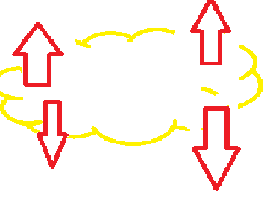
Animal cell placed in water with high water potential
Cell absorb water and increase size
Cell burst opens

Slide 22
Plant cell placed in solution of low water potential (HYPERTONIC)
Plant cell will loose water by osmosis
The cell size will reduces
Called plasmolysis (shrinkage)

Slide 23
Animal cell placed in solution of low water potential (HYPERTONIC)
When animal cell is placed in hypertonic solution, it losses water by osmosis
Cell size reduces and phenomenon is called Crenation

Slide 24
Importance of turgor pressure in plants
Tender (non woody) plants are erect because of turgor pressure
Leaf movements
Touch me not plant movement

Slide 25
Passive transport
Transport along concentration gradient (higher to lower)
osmosis
diffusion

Slide 26
Active transport
Movement of substances against concentration gradient.
Minerals, foods (glucose, amino acids, fatty acids) are absorbed by active transport.
Cell membrane have some pumps to absorb these substances against concentration gradient.
Such pumps uses a lot of energy

Slide 27
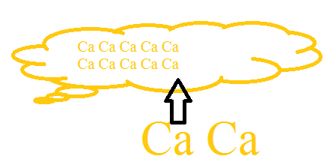
Internal concentration is high
Till cell absorb it

Slide 28
Surface area to volume ration

