Slide 1
Yersinia enterocolitica

Slide 2
Scientific Calssification
Kingdom: Bacteria
Phylum: Proteobacteria
Class: Gamma Proteobacteria
Order: Enterobacteriales
Family: Enterobacteriaceae
Genus: Yersinia
Species: Y. enterocolitica

Slide 3
Yersinia
Member of Enterobacteriaceae
Gram negative, small rod shape
Y. enterocolitica
Y. pseudotuberculosis
Y. pestis

Slide 4
Public health significance
Y. enterocolitica, Y. pseudotuberculosis, Y. pestis are the three pathogenic species
Y. enterocolitica and Y. pseudotuberculosis cause the food borne disease.
Y. pestis causes the bubonic plague or black death in Europe

Slide 5
Yersinia enterocolitica
O:3 and O:9 in Europe, O:8 in the US and O:5 and O:7 in Japan and Canada are specific to different geographical areas
The infectious dose is of 10⁸ bacteria or more orally
The incubation period for this bacterium is between 3-10 day

Slide 6
Transmission
Human-to-human transmission - schools, daycares and hospitals
Nosocomial infections and blood transfusion
Fecal-oral transmission from animal-to-human or consumption of contaminated foods (raw pork products, undercooked pork, tofu and unpasteurized milk have been shown to be a source of outbreaks)
Untreated water are also common modes of transmission

Slide 7
Transmission
Optimum temperature 22-29°C (range of -2 to 45°C)
Foods involved in transmission;
Meats (pork, beef, lamb, etc.)
Oysters, fish
Raw milk

Slide 8
Susceptible population
Infants, children
Compromised adults
Individuals with the antigen HLA-B27 (postenteritis arthritis)

Slide 9
Yersiniosis
Only Y. enterocolitica and Y. pseudotuberculosis cause gastroenteritis
Symptoms;
Gastroenteritis
Abdominal pain, diarrhea (often bloody) , vomiting, fever
In older children and adults, right-sided abdominal pain (pseudo-appendicitis)
Right sided abdominal pain may be confused with appendicitis.
In a small proportion of cases, complications such as skin rash, joint pains, or spread of bacteria to the bloodstream can occur.

Slide 10
Yersiniosis
Onset illness
Occasional Y. enterocolitica GI infection followed by arthritis of peripheral joints
2 - 6 weeks after intestinal infection clears
Called reactive arthritis (Reither’s syndrome)
may occur even in the absence of obvious symptoms.

Slide 11
Outbreaks
http://www.cdc.gov/search.do?action=search&direction=desc&queryText=yersinia&sort=date&subset=mmwr

Slide 12
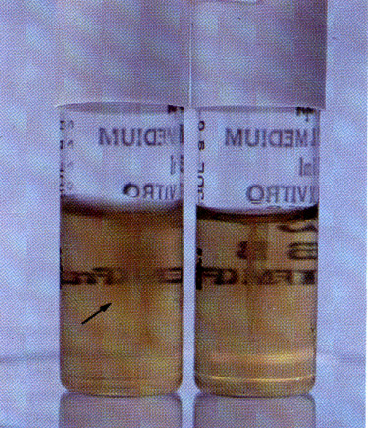
Y. enterocolitica
Low temperature pathogen
Able to grow at 4°C
Some biochemical characteristics are temperature dependent
Expose at 28-30°C but not at 37°C
Mobile below 30°C but not at 37°C
Incubation at 37°C →loss of the virulence
plasmid & plasmid mediated properties
Yersinia is psychrotroph.
So, may continue to grow under refrigeration

Slide 14
Yersinia species have a smaller colony diameter than other member of Enterobacteriaceae such as E. coli

Slide 17
Ways to Prevent Food Poisoning
Wash hands thoroughly
Don’t eat raw or undercooked meat
Drink only pasteurized milk

