Slide 1
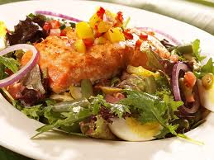
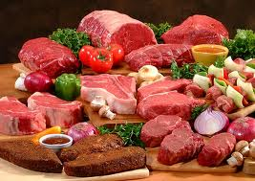
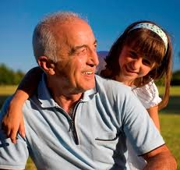
Incorporation of antioxidants and dietary fiber
in meat products
for health improvements
Dr. Divya
Central Avian Research Institute
Izatnagar, Bareilly, U.P.243 122

Slide 2
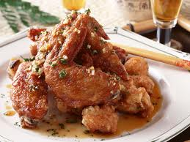
Meat
Meat and meat products-
proteins, vitamins, and minerals.’
Certain approaches for modification in meat and meat products

Slide 3
Criticism of Meat
Meat is a healthy food
Being criticized on account of –
For excess fat
Saturated fat and cholesterol
Circulatory problem- Hypertension
Low gut movement- constipation colon cancer etc.

Slide 4
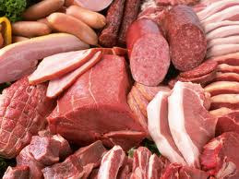
A new report suggests that eating too much red meat and processed meat can have a riskier for our health than we think
negative image of meat foods, and their possible health hazard effects, shows that consumers are increasingly interested about health oriented functional meat products

Slide 5
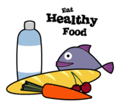
Consumers require not only improved taste but also be attractive, safe and healthy.
alteration of the fatty acid and cholesterol levels in meat.
-addition of natural extracts with antioxidant properties, limiting sodium chloride, incorporation of dietary fibers etc
giving more emphasis on antioxidants and dietary fibre for health benefits of the consumers

Slide 6
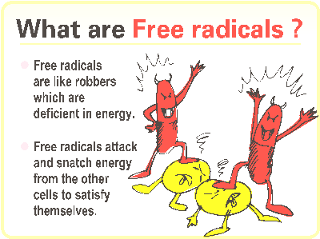
Excess free radical production is cause of the pathogenesis of diseases like atherosclerosis, carcinogenesis, diabetes, cataract and accelerated ageing and some degenerative diseases .

Slide 7
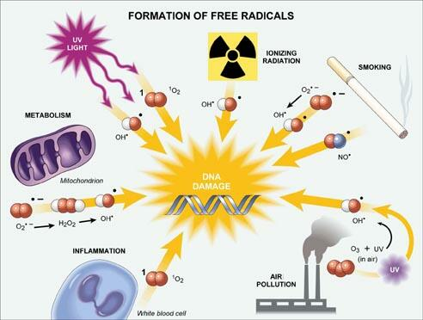

Slide 8
Mechanism for the formation of free radicals
Free radicals can be formed by three ways -
By homolytic cleavage of covalent bond of normal molecule, with each fragment retaining
one of paired electrons.
X : Y X* + Y*
 By the loss of single electron from normal molecule.
X : Y X⁺ + Y⁻
By addition of single electron to normal molecule.
X + e- X⁻

Slide 9
Free Radical Oxidation
Stable antioxidant
radical breaks the cycle
(unstable peroxyl radical)
Aldehydes, organic acids, alcohols, ketones
(hydroperoxide breakdown products contribute off flavors)

Slide 10
Antioxidants
Antioxidant means "against oxidation." Antioxidants are an inhibitor of the process of oxidation, even at relatively small concentration and thus have diverse physiological role in the body .
Antioxidants may be defined as compounds that inhibit or delay the oxidation of other molecules by inhibiting the initiation or propagation of oxidizing chain reactions.

Slide 11
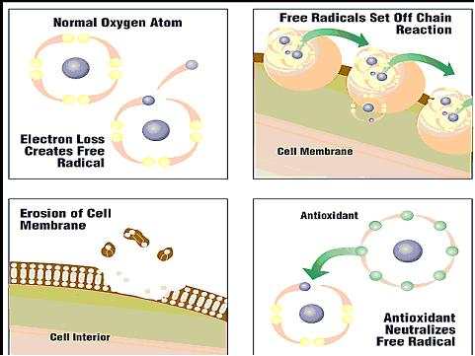
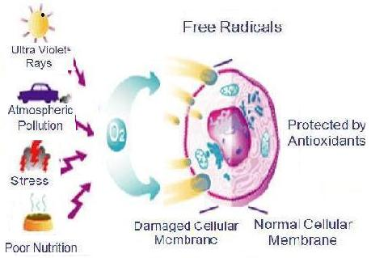
Antioxidant
An antioxidant is a molecule stable enough to donate an electron to a rampaging free radical and neutralize it, thus reducing its capacity to damage. These antioxidants delay or inhibit cellular damage mainly through their free radical scavenging property

Slide 12
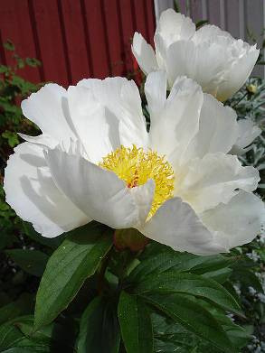

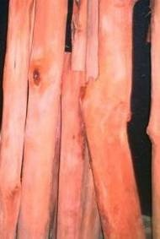
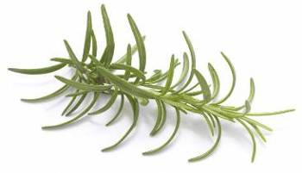
Natural antioxidants
Consumers are demanding more natural foods
industry to include natural antioxidants in foods.
Natural antioxidants have been used instead of synthetic antioxidants to retard lipid oxidation in foods to improve their quality and nutritional value.
There has been a growing interest in natural ingredients because they have greater application in food industry for increasing the consumer acceptability, palatability, stability and shelf life of food products.
Consequently, search for natural additives, especially of plant origin, has notably increased in recent years.
white peony
Sappanwood - heartwood
Rosemary

Slide 13
Synthetic antioxidants
The most effective synthetic antioxidants are approved by Food and Drug Administration for addition to foods,
BHA (Butylated hydroxyanisole),
BHT (butylated hydroxy toluene),
TVHQ (tertiary butylated hydroxy quinone) etc
synthetic antioxidant market worldwide is in decline, while natural antioxidants are growing, prepared by consumer acceptance with ease and legal requirements for market access.
In addition to extending the shelf life, natural antioxidants have been reported to enhance the organoleptic characteristics and consumer acceptability of meat and meat products with added health benefits.

Slide 14
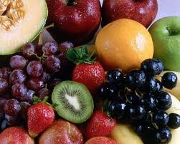
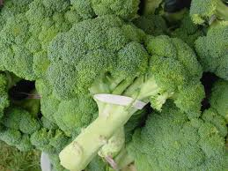
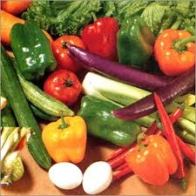
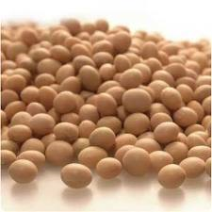
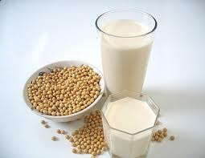
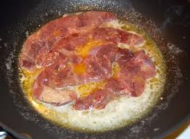
Types and sources of Natural antioxidant
Polyphenolic compounds
Carotenoids
Vitamin-A
Vitamin-C
Vitamin E
CoQ10 (an antioxidant enzyme)

Slide 15
Antioxidant defense system
Antioxidants act as
radical scavenger,
hydrogen donor,
electron donor,
peroxide decomposer,
singlet oxygen quencher,
enzyme inhibitor,
metal-chelating agents.

Slide 16
Mechanism of action of antioxidants
Two principle mechanisms -for antioxidants
chain- breaking mechanism by which the primary antioxidant donates an electron to the free radical present in the systems.
The second mechanism involves removal of ROS/reactive nitrogen species initiators (secondary antioxidants) by quenching chain-initiating catalyst.
Antioxidants may exert their effect on biological systems by different mechanisms including electron donation, metal ion chelation, co-antioxidants.

Slide 17
Three major levels of antioxidant defense in the cell
Free radicals
Free radicals
First level of defense
Second level of defense
Third level of defense
Se-GSH-Px
Glutathione
Uric acid
Lipases, proteases, etc
Vitamins A, E, C, carotenoids
Metal-binding
proteins
, Free radicals
Catalase
Free radicals

Slide 18
Levels of antioxidant defense in the cell
The first line of defense is the preventive antioxidants, which suppress the formation of free radicals.
The second line of defense is the antioxidants that scavenge the active radicals to suppress chain initiation and/or break the chain propagation reactions
The third line of defense is the repair and de novo antioxidants. The proteolytic enzymes, proteinases, proteases, and peptidases, present in the cytosol and in the mitochondria of mammalian cells

Slide 19
………..Pathways and biological effects of natural antioxidants
Polyphenols anthocyanins flavonoid
antioxidants donate electrons from two major electron rich sources: hydroxyl groups and double bonds.
the donation of hydrogen atoms from their multiple hydroxyl groups which protrude from their central ring structure.
antioxidants prevent oxidation is to use double bonds to donate electron density.
Vitamin C or ascorbic acid -donating hydrogen atoms from its own hydroxyl groups

Slide 20
Function of antioxidant
Many natural antioxidants have been much touted for their positive effects on health, especially applications that prevent cancer and heart disease.
While each antioxidants works in a different manner, the act of preventing or reversing oxidation, which is a natural occurrence in many physiological processes, is ypothesized to have significant effects in the prevention of many diseases.
When tocopherols, in particular vitamin E is consumed, it is passed through the liver and transferred to adipose where it prevents oxidation.
Additionally, it is thought that carotenoids may have some regulatory function in cells, but no conclusive evidence has been found to support this hypothesis.

Slide 21
Antioxidants in Human health
Several antioxidants have been identified as agents to overcome and reduce the incidence or controlling the harmful effect during the diseases clinical conditions related to human health.
cancer,
cardio­vascular disease,
atherosclerosis,
hypertension,
ischemia / re-perfusion,
diabetes mellitus,
hyperoxaluria,
Neuro­degenerative diseases -Alzheimer’s and Parkin­son’s diseases, rheumatoid arthritis etc.

Slide 22
…….Antioxidants in Human health
Considerable research demonstrates the human health benefits of naturally occurring antioxidant compounds.
Claims of Various properties
anti-viral,
anti-inflammatory,
anti-cancer,
anti-mutagenic,
anti-tumour,
hepatoprotec­tive
have been substantiated, albeit mostly from in vitro trials.

Slide 23
………Antioxidants in Human health
Oxidation reactions in the body could be linked to the build-up free radicals fatty deposits that cause blockages in arteries that can cause heart attacks.
Antioxidants may be important in preventing this and there could also be a link with the prevention of certain cancers, arthritis and other conditions.
The picture is not yet clear and a great deal of research needs to be undertaken.

Slide 24
Care before addition in new food
Processing of any new food require review of food law.
Permissible level of addition
Acceptance by the consumer
Test, texture appeal and quality of food

Slide 25
Natural extracts with antioxidant properties
Lipid oxidation is one of the causes for the deterioration of meat and derivatives because their appearance determines the onset of a large number of undesirable changes in flavor, texture, and nutritional value.
The rate of lipid oxidation can be effectively retarded by the use of antioxidants.
Synthetic antioxidants were widely used in the meat industry, but consumer concerns over safety and toxicity pressed the food industry to find natural sources.

Slide 26
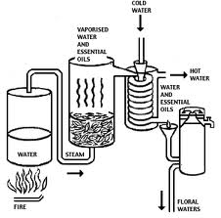
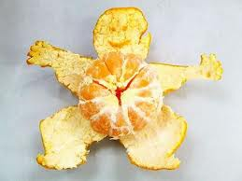
………….Natural extracts with antioxidant properties
Natural antioxidants extracted from plants -rosemary, sage, tea, soybean, citrus peel, sesame seed, olives, carob pod, and grapes can be used as alternatives to the synthetic antioxidants because of their equivalent or greater effect on the inhibition of lipid oxidation.
The human intake of green tea decreases total cholesterol, increases the high-density lipoprotein (HDL) fraction, and decreases lipoprotein oxidation.
The high affinity of tea catechins for lipid bilayers of muscle and their free radical scavenging abilities may provide a possible mechanism to explain the inhibition of lipid oxidation in cooked muscle food.

Slide 27
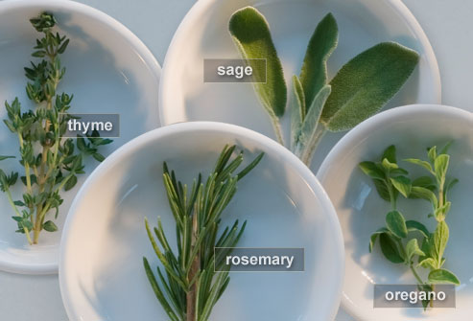
………….Natural extracts with antioxidant properties
Another extract used in meat products is rosemary, from whose leaves a large number of phenolic compounds with antioxidant activities have been isolated.
These include carnosol, carnosic acid, rosmanol, epirosmanol, isorosmanol, rosmarinic acid, rosmaridiphenol, and rosmariquinone

Slide 28
Dietary fibres in meat products
Dietary fibre consists of edible plant cells -cellulose, hemicellulose, lignin, pectins and a variety of gums and mucilages.
An adequate fibre diet has a variety of specific healthful benefits, the major one of which is optimizing gastrointestinal physiological function.
Fibre is suitable in meat products and has previously been used in meat emulsion products because it retains water, decreasing cooking losses without affecting flavour of cooked product.
Sugarbeet, wheat, oat and pea fibre have been used, mainly in cooked meat products.

Slide 29
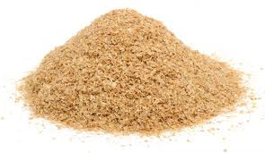
…….Dietary fibres in meat products
Vitacel (wheat fibre) have been added in three different meat products;
cooked and cured ham,
fresh sausage
emulsified bologna.
The most important property of fibre from a technological standpoint is that of ability to bind water.
The use of fibres can assist the restructuring of products and in most meat products, the uses of these fibres can help achieve the right texture in restructuring of previously ground muscle.

Slide 30
…….Dietary fibres in meat products
Pork sausage products containing dextrin, a water soluble dietary fibre made from potato starch, are claimed to have beneficial effects on intestinal disorders.
As fibre allows more addition of water at the expense of fat and proteins, the fibre added products have a lower cost than their traditional versions.
The functional properties of the fibre and the decrease in the product caloric content allows for marketing as healthy alternative , taking advantage of growing health concerns of the consumers.

Slide 31
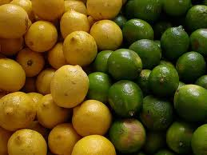
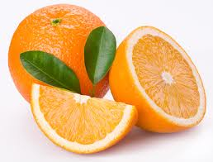
…….Dietary fibres in meat products
By products of citrus fruits processing industries represent a serious problem, promising sources of materials which may be used in the meat industry because of their technological and nutritional properties.
Limes, orange and lemons were probably the first clinically documented functional foods.

Slide 32
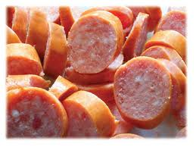
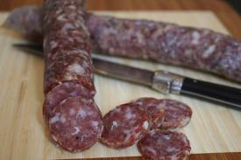
…….Dietary fibres in meat products
Most of these materials from citrus by products could be used as functional ingredient when designing healthy foods, especially non-digestible carbohydrates (dietary fibre) and bioactive compounds (ascorbic acid and flavonoids).
Dry fermented meat sausage- for increasing soluble fibre content- Citrus fruit
.
The main advantage of dietary fibre from citrus fruits when compared to alternative sources of fibre such as cereals is its higher proportion of soluble dietary fibre with about 33% in citrus fruits while only 7% is present in wheat bran.
There is great interest in increasing the consumption of oat based products that contain both soluble and insoluble fibres

Slide 33
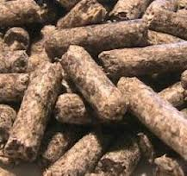
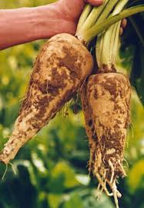
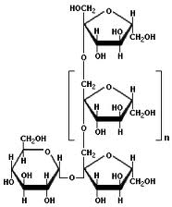
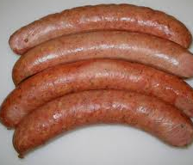
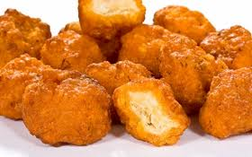
…….Dietary fibres in meat products
Fat substitutes - Several dietary fibers have been used in meat products.
Dietary fibers - oat, sugar beet, soy, pea etc., have been tried in the formulation of some meat products such as patties and sausages
Swelite, a natural ingredient extracted from smooth yellow peas and containing 60% dietary fiber have been used in frozen hamburger.
Soy hulls have been incorporated for the preparation of high fiber camel meat patties.
In dry fermented sausage, the addition of inulin, a low calorie product (30% of the original), enriched with soluble dietary fibre (10% approximately) could be obtained. Rye bran as a fat substitute has been used in the meatballs and it was observed that meatballs containing rye bran had lower concentrations of total fat and total trans fatty acids.

Slide 34
…….Dietary fibres in meat products
But increasing fiber consumption in the diet is always a difficult challenge. That is why fiber usually used in food products, should not only supply fiber, but also provide enhanced functional properties to make high-fiber foods like taste better, thus and encouraging continued high fiber intake.
In many instances, these dietary fibers not only have beneficial physiological effects, they also generate important technological properties that offset the effect of fat reduction.
I have added Gum Arabic and guar gum in poultry and goat nuggets and observed increased functional properties, cooking yield, reduction in oil incorporation with improvement in test and texture.

Slide 35
Dietary fibers in human health
Fibers are naturally occurring compounds present in variety of vegetables, fruits, cereal flours etc
Function
solubility,
viscosity,
gel forming ability
water-binding capacity,
oil adsorption capacity
mineral and organic molecule binding capacity
which affect product quality and characteristics.

Slide 36
……….Dietary fibers in human health
High-fiber intake tends to reduce risk of
colon cancer,
obesity,
cardiovascular diseases,
several other disorders.
Moreover, based on their physiochemical properties, many fibers can help to improve colour, texture and sensorial characteristics instead of nutritional benefits

Slide 37
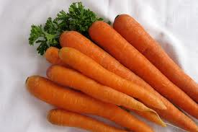
…….Dietary fibers in human health
Raw carrot (Daucus carota) richest source of β-carotene, iron, pectin, dietary fibre, complex carbohydrate, and various minerals.
β- carotene prevents the appearance or impedes the development of cancerous cells.
It has potent antioxidant effect, also provides anti-mutagenic, anti-tumoral, immunostimulant, antiulceric, degenerative properties on human health.
Carotenoid -protect our body- vision, skin, teeth and gums. Besides β- carotene, iron is very suitable for human health. Iron is very digestible and also favors the formation of the red globules.

Slide 38
…….Dietary fibers in human health
Meat and meat products can be modified by adding ingredients considered beneficial for health or by eliminating or reducing components that are considered harmful.
The use of these ingredients in meat products offers processors the opportunity to improve the nutritional and health qualities of their products.
The results suggest that many ingredients can be used in the meat industry to add functional properties to meat products, and further research is needed to understand their interactions with meat products constituents and thus to improve their safety in potential industrial applications.

Slide 39
…….Dietary fibers in human health
Functional food development is a multistage process that requires input from commercial, academic and regulatory interests, with a critical need to achieve acceptance by consumers.
Chronic health problems associated with ageing and realize that dietary intervention can be safe and cost effective alternative to drugs or other more traditional therapies.

Slide 40
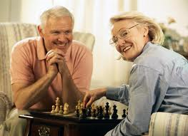

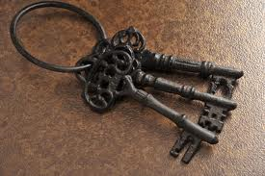
Stay active..
Stay healthy..
Healthy aging
Thanks

